Slide 1
Correlation between
All Inclusive Hotels and Feedback score

Slide 2
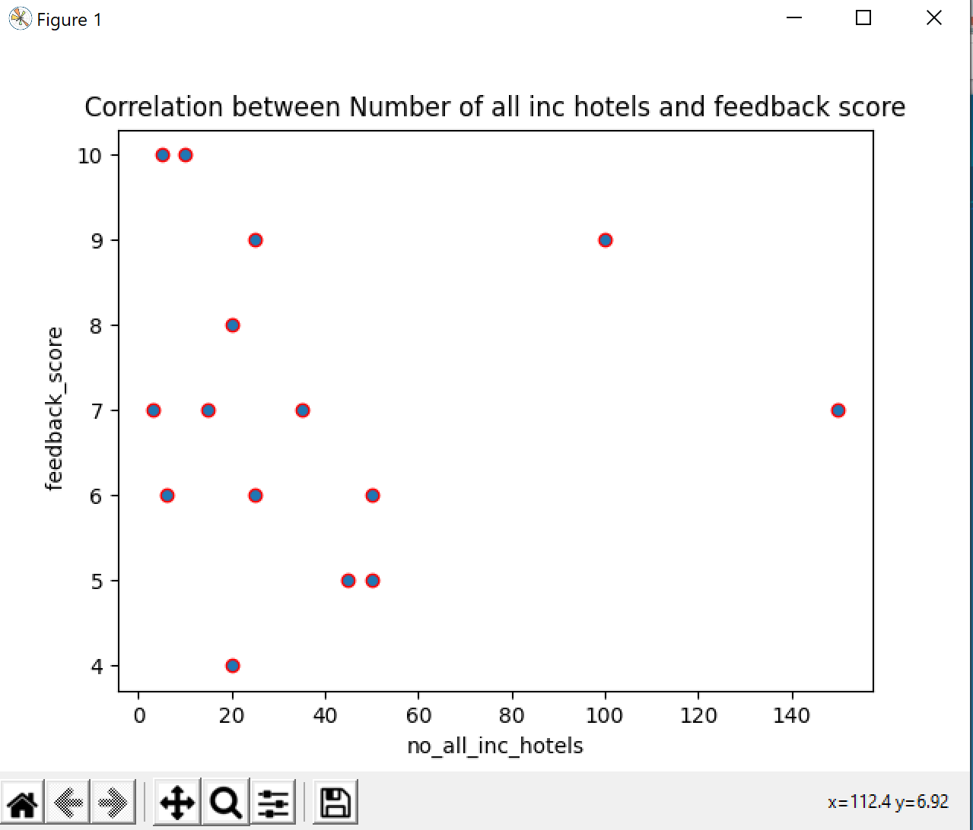
Finding a correlation
Notes:
As you can see the above Scatter Graph illustrates and shows that the lower the number of all inclusive hotels the higher the feedback score this may particularly be eveident with small islands such as the Maldives and Seychelles.

Slide 3
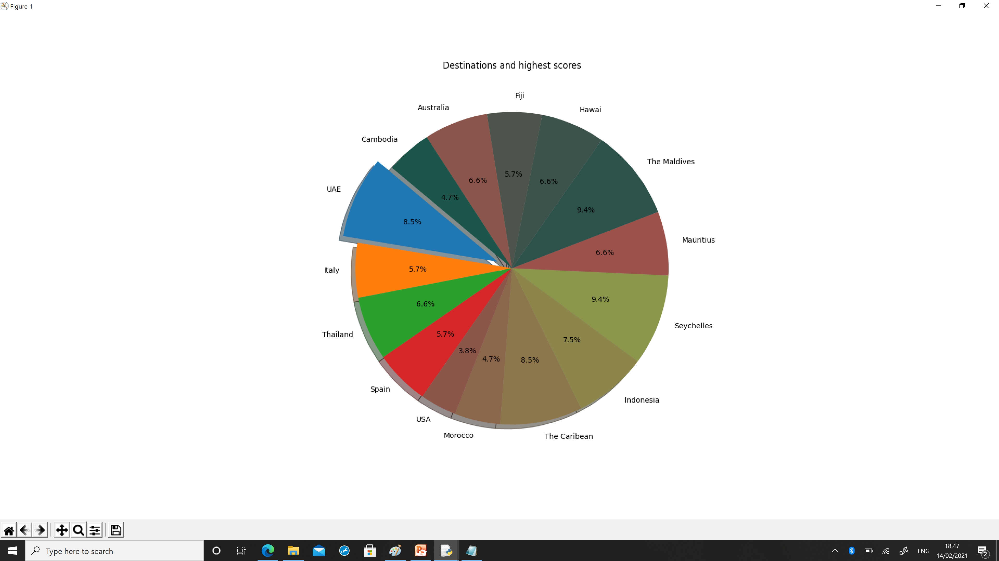
visualisation
Destinations and highest scores
Notes:
The Pie chart illustrates the highest scoring destinations. The Maldives and Seychelles scoring the higest feedback score.

